Slide 1

St. Juan Macias Missioners, Inc

Slide 2
Empower Individuals,Communities To Be An Oasis Of Faith, Hope And Love In Christ Through Spirituality, Healing And Change
St. Juan Macias Missioners, Inc

Slide 3
Problem worth solving
Rise in homelessness over the past 20-25 years: a growing shortage of affordable rental housing and a simultaneous increase in poverty. Persons living in poverty are most at risk of becoming homeless.
St. Juan Macias Missioners, Inc

Slide 4
Mental Disorders
Adults with any type of mental illness in the past year: 45.1 million. (SAMHSA)
Adults with serious mental illness: 11 million. (SAMHSA)
Published studies report that about 25 percent of all U.S. adults have a mental illness and that nearly 50 percent of U.S. adults will develop at least one mental illness during their lifetime. (CDC)
Nearly one-fourth of all adult stays in U.S. community hospitals involve depressive, bipolar, schizophrenia and other mental health disorders or substance use-related disorders. (AHRQ) (PDF, 615KB)
According to the Substance Abuse and Mental Health Services Administration, 20 to 25% of the homeless population in the United States suffers from some form of severe mental illness.

Slide 5
Our solution
Through Eco Therapy, it is possible to lead those who experience bio-psychosocial problems to feel less isolated and be stimulated to restructure their cognitions and develop new expectations of their reality through use of commercial farms.
St. Juan Macias Missioners, Inc

Slide 6

Target market
1.5M
NYS MH Client
Homeless In NY State
Prospects
Wealth Near Area
Market size
$934.4M
St. Juan Macias Missioners, Inc

Slide 7
Competitive landscape
Competitors | How our solution is better
Hundred Acres Farm-Vermont | More flexible cost, helping homeless.
Cooper-Riis-N. Carolina | Provide direct life skills, flex cost
Rose Hill-MI Guild Farm-MA Spring Lake Ranch- VT Hopewell-OH | Provide direct life skills, flex cost.
St. Juan Macias Missioners, Inc

Slide 8
Funding needed
$5M
Construction of retreat and training center, homes for client, operating cash, employee compensation.
St. Juan Macias Missioners, Inc

Slide 9
Sales channels
Through outreach and pr team, we will provide direct outreach to clients on streets and shelters, promotion to hospitals, agencies, website and literature, internet adds.
St. Juan Macias Missioners, Inc

Slide 10
Marketing activities
Websites for: Mission recruitment and social advocacy, therapeutic mental health farm, counseling and consulting, retreat center. Missions, volunteer and mental health fairs, trade adds, city adds, brochures, news letters are all utilized.
St. Juan Macias Missioners, Inc

Slide 11
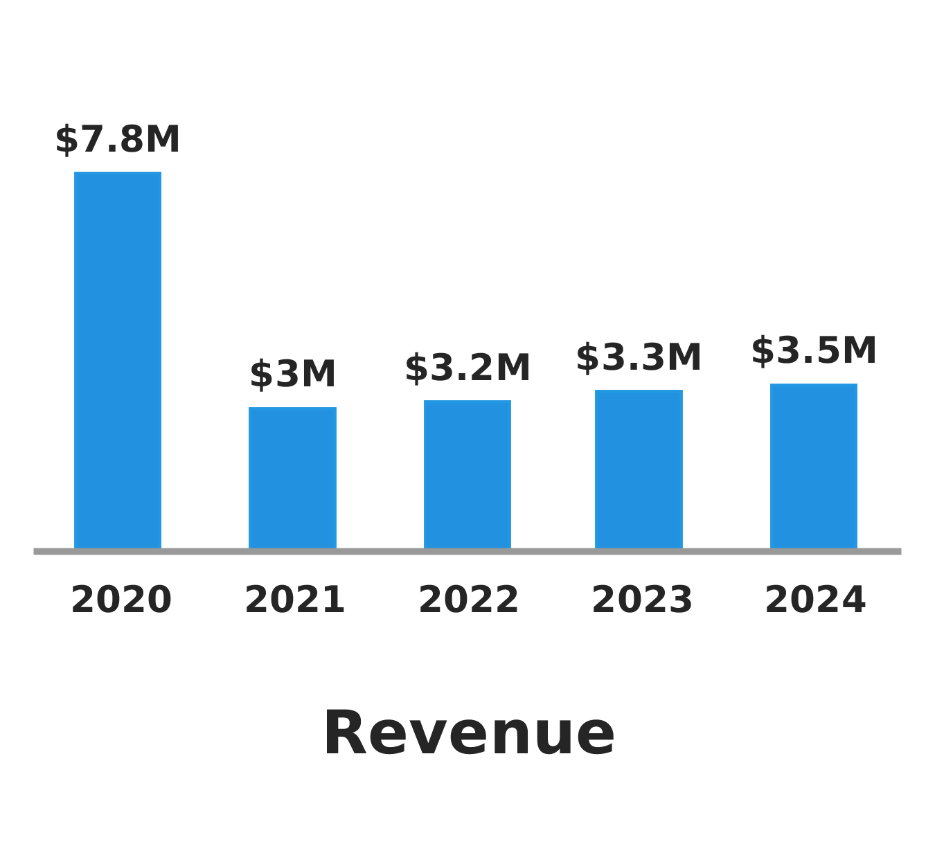
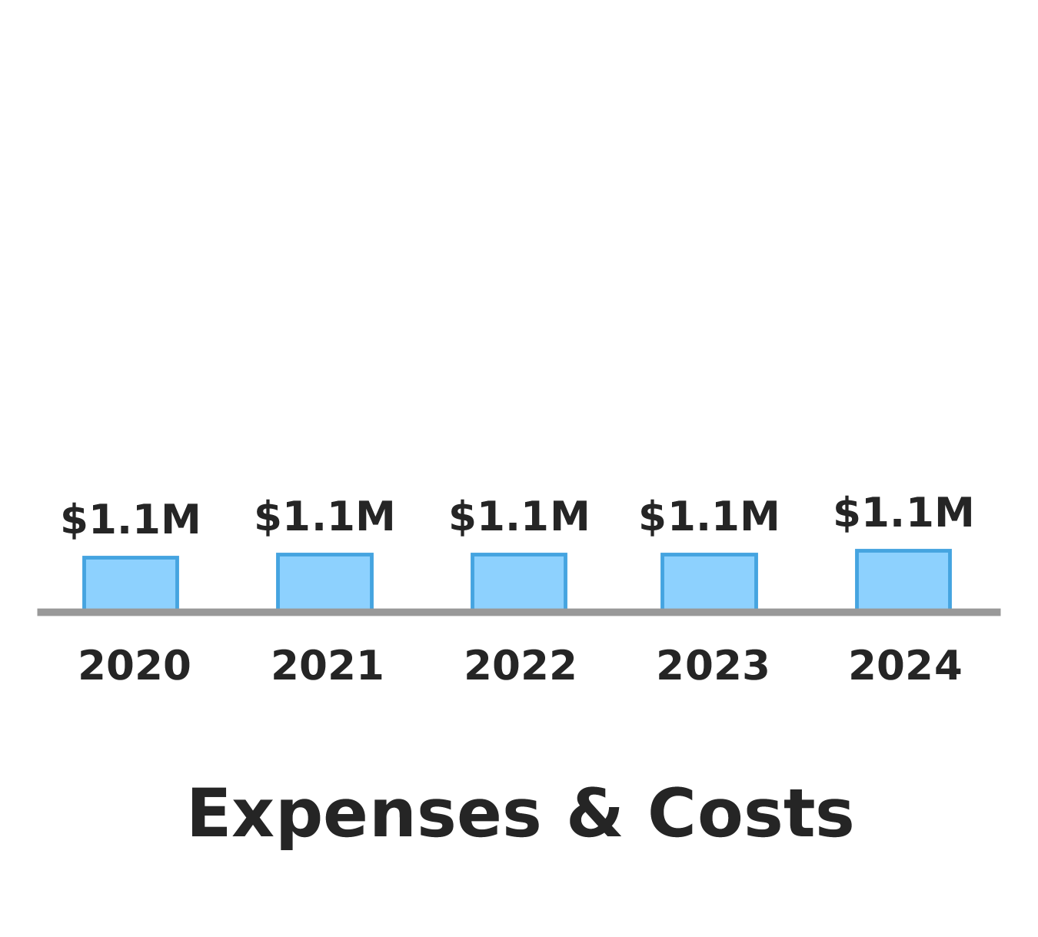
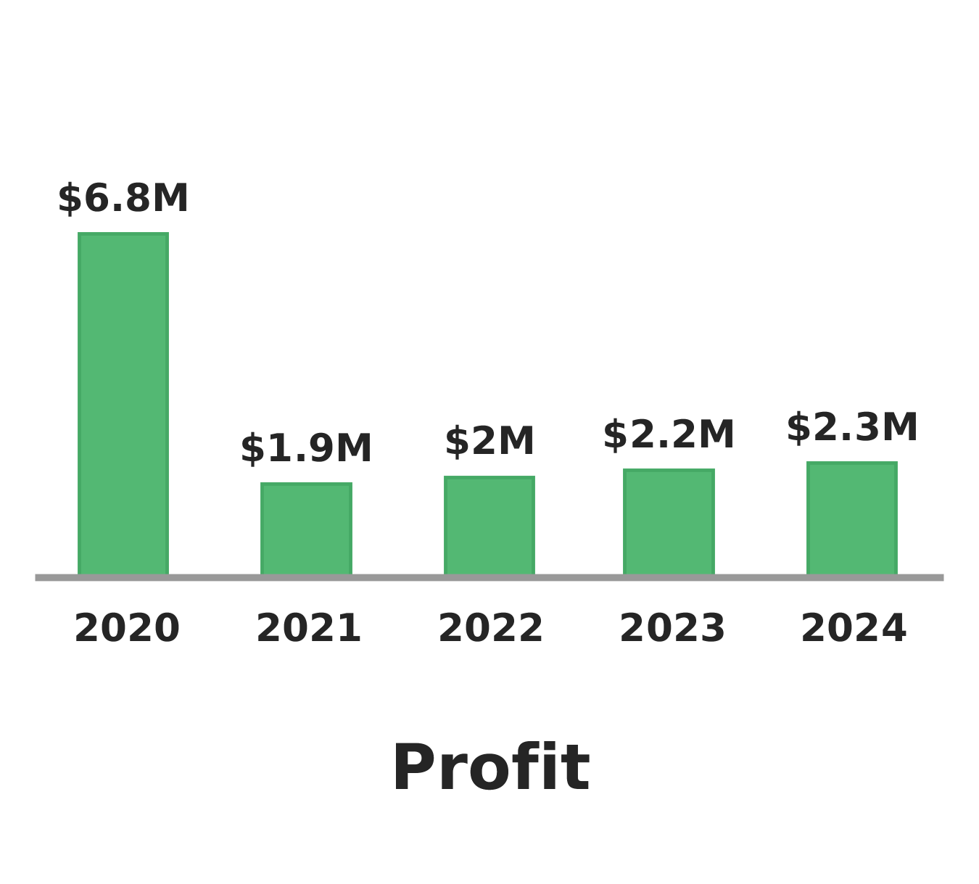
Financial Projections
St. Juan Macias Missioners, Inc

Slide 12

Milestones
Due Date | Milestone
February 1, 2019 | plan india trip
May 1, 2019 | Recruit all board members
September 1, 2019 | Raise funds to support volunteers
March 1, 2020 | Recruit volunteers-plan prjct--raise all funds
September 1, 2020 | Purchase land, homes, begin construction, staffing, plan
St. Juan Macias Missioners, Inc

Slide 13
Projected Profit & Loss (1 of 2)
Net profit in 2020
Net profit by year
$8M
$8M
$6M
$6M
$4M
$4M
$2M
$2M
$0
$0
Jan '20
Feb '20
Mar '20
Apr '20
May '20
June '20
July '20
Aug '20
Sept '20
Oct '20
Nov '20
Dec '20
2020
2021
2022
2023
2024

Slide 14
Projected Profit & Loss | 2020 | 2021 | 2022 | 2023 | 2024
Revenue | $7,840,472 | $2,996,810 | $3,153,138 | $3,309,476 | $3,465,809
Grants and Donations | $768,785 | $768,785 | $768,785 | $768,785 | $768,785
Fundraising | $50,000 | $50,000 | $50,000 | $50,000 | $50,000
Client Fees | $1,097,010 | $1,097,010 | $1,097,010 | $1,097,010 | $1,097,010
other consulting | $24,677 | $37,015 | $49,343 | $61,681 | $74,014
Business Loan | $5,000,000
Retreat Center | $756,000 | $756,000 | $756,000 | $756,000 | $756,000
spa services | $144,000 | $288,000 | $432,000 | $576,000 | $720,000
Direct Costs | $61,008 | $61,008 | $61,008 | $61,008 | $61,008
Buisness Services | $61,008 | $61,008 | $61,008 | $61,008 | $61,008
Gross Margin | $7,779,464 | $2,935,802 | $3,092,130 | $3,248,468 | $3,404,801
Gross Margin % | 99% | 98% | 98% | 98% | 98%
Operating Expenses | $823,201 | $841,351 | $860,020 | $879,230 | $898,993
Salaries & Wages | $700,489 | $716,575 | $733,121 | $750,146 | $767,661
CEO | $62,090 | $63,953 | $65,871 | $67,847 | $69,883
Ast. Book keeper | $5,760 | $5,933 | $6,111 | $6,294 | $6,483
book keeper | $35,450 | $36,514 | $37,609 | $38,737 | $39,899
Clinical Director | $48,785 | $50,249 | $51,756 | $53,309 | $54,908
Director of Operations | $46,124 | $47,508 | $48,933 | $50,401 | $51,913
Marketing Director | $35,450 | $36,514 | $37,609 | $38,737 | $39,899
HR Director | $44,350 | $45,681 | $47,051 | $48,462 | $49,916
Reception/Secretarial | $31,045 | $31,976 | $32,936 | $33,924 | $34,941
Therapist | $47,011 | $47,011 | $47,011 | $47,011 | $47,011
Volunteer Stipends | $31,045 | $31,355 | $31,669 | $31,986 | $32,306
Nursing/psychiatric | $31,045 | $31,976 | $32,936 | $33,924 | $34,941
continued on next page...
Projected Profit & Loss (2 of 2)
...continued from previous page

Slide 15
Projected Profit & Loss | 2020 | 2021 | 2022 | 2023 | 2024
PM Security p/t | $21,258 | $21,471 | $21,685 | $21,902 | $22,121
Ranching | $31,045 | $31,045 | $31,045 | $31,045 | $31,045
Head chef | $39,915 | $40,314 | $40,717 | $41,124 | $41,536
Kitchen Assistantsp/t (3) | $24,834 | $24,834 | $24,834 | $24,834 | $24,834
case managers (2) | $62,090 | $63,952 | $65,872 | $67,848 | $69,882
House keeping p/t (2) | $42,576 | $43,854 | $45,168 | $46,524 | $47,920

Slide 16
Maintenance | $33,706 | $34,717 | $35,759 | $36,831 | $37,936
Maintenance p/t | $8,520 | $8,776 | $9,039 | $9,310 | $9,589
Receptionists p/t (2) | $18,390 | $18,942 | $19,510 | $20,096 | $20,698
Employee Related Expenses | $84,264 | $86,328 | $88,451 | $90,636 | $92,884
Employee Benefits | $38,448 | $38,448 | $38,448 | $38,448 | $38,448
Operating Income | $6,956,263 | $2,094,451 | $2,232,110 | $2,369,238 | $2,505,808
Interest Expense | $181,999 | $195,115 | $191,393 | $187,520 | $183,489
Income Taxes | $0 | $0 | $0 | $0 | $0
Depreciation and Amortization | $877 | $876 | $877 | $877 | $854
Gain or Loss from Sale of Assets |  |  |  |  | ($1,689)
Total Expenses | $1,067,085 | $1,098,350 | $1,113,297 | $1,128,635 | $1,146,034
Net Profit | $6,773,387 | $1,898,460 | $2,039,841 | $2,180,841 | $2,319,775
Net Profit % | 86% | 63% | 65% | 66% | 67%

Slide 17




Team and Key Roles
Mark Silla LPCC, MAPS
Cristina Romano B.A.
Jennifer Thiel BSN, RN
Steve Thiel PA
Medical Consultant
CEO
Board Memeber
Medical Consultant
St. Juan Macias Missioners, Inc

